Slide 1
The State of Password Storage in the Wild
Teodor Dobre
Notes:
Passwords are the most used form of authentication on the internet. They are stored on servers as hashes using a process called passwords hashing by way of different hashing functions, which makes them unintelligible from their plain text forms.

Slide 2
Objectives
Show the evolution in the usage of hashing functions, as well as the overall picture with data from HaveIBeenPwned
Gather dehashed/plain text password databases from leaks and show the distribution in password strength of these databases using ZXCVBN
Draw conclusions based on the results of the analysis with regards to the different storage methods
Notes:
Here are the main objectives of this project:
First, we show the overall picture and evolution of hashing functions used, using data on leaks from HaveIBeenPwned.
Next, we gathered actual password databases from leaks and analyzed the strength of the passwords in them using the ZXCVBN library.
Finally, we drew conclusions from our results and formed possible hypotheses that might explain them

Slide 3
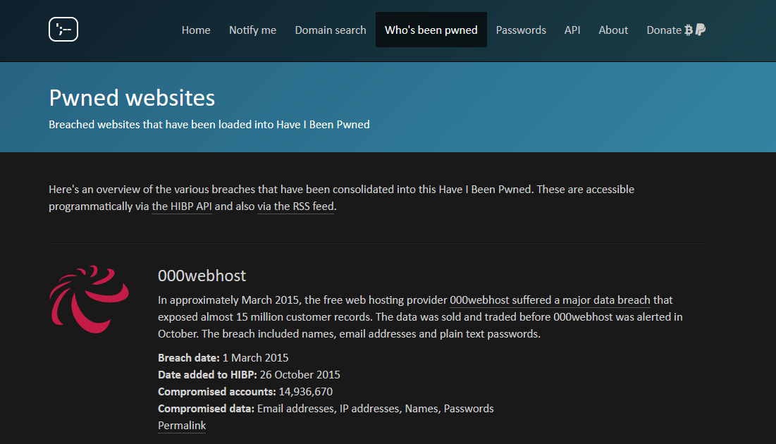
Data Gathering
Notes:
Our first step was data gathering. For this, we used the “Who’s been pwned” page on the HaveIBeenPwned website

Slide 4
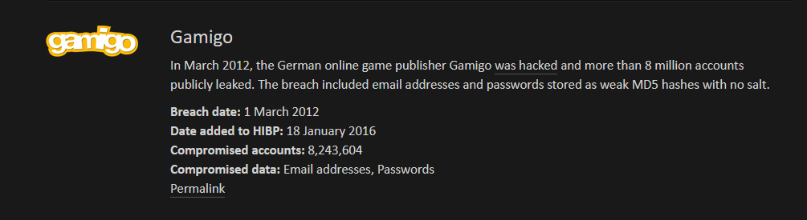
Data Gathering
Notes:
When creating our database, we were only interested in specific leaks listed. First, passwords needed to be part of the compromised data. If a leak had this, we then extracted the leak name, the date it happened, the date it was added to HIBP, the number of passwords leaked, the hashing used and if salt was used.

Slide 5
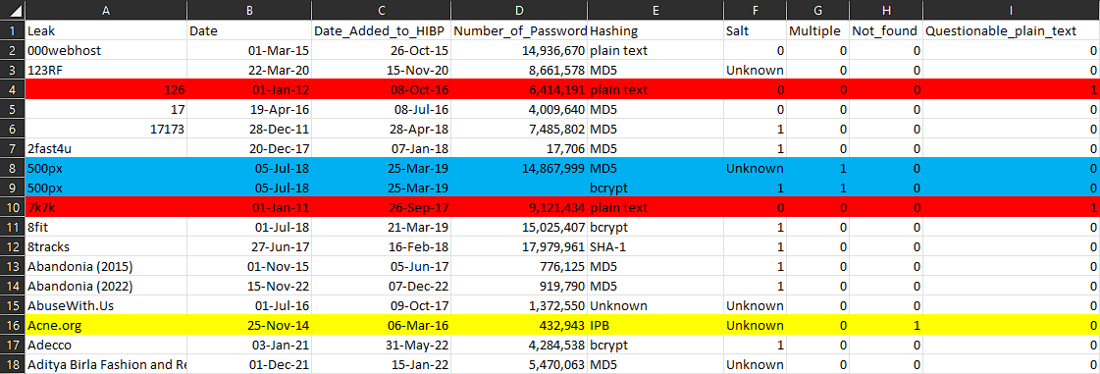
Database of Leaks
Notes:
We then ended up with a database of 537 leaks. Of note are the three columns at the end, which signify our manual input, which are explained in the dissertation. Specifically, we had to manually resolve leaks which had multiple hashing methods listed, leaks for which our script could not find the hashing used, and leaks for which we were uncertain if the passwords were stored in plain text, or were dehashed and later leaked this way.

Slide 6
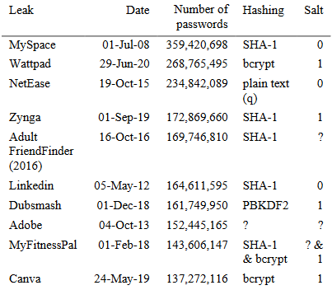
Top 10 Leaks
Founded before 2007
All leaks from US
MyFitnessPal transition
Notes:
Here are the top 10 leaks in our database by number of passwords. Of not is that 5 of the 10 used SHA-1 hashing. Our hypothesis to explain this is that SHA-1 was the hashing used by these companies when they were first created, and by the time they grew so large it would have been too expensive to migrate the passwords. We present arguments that support this in the dissertation as well

Slide 7
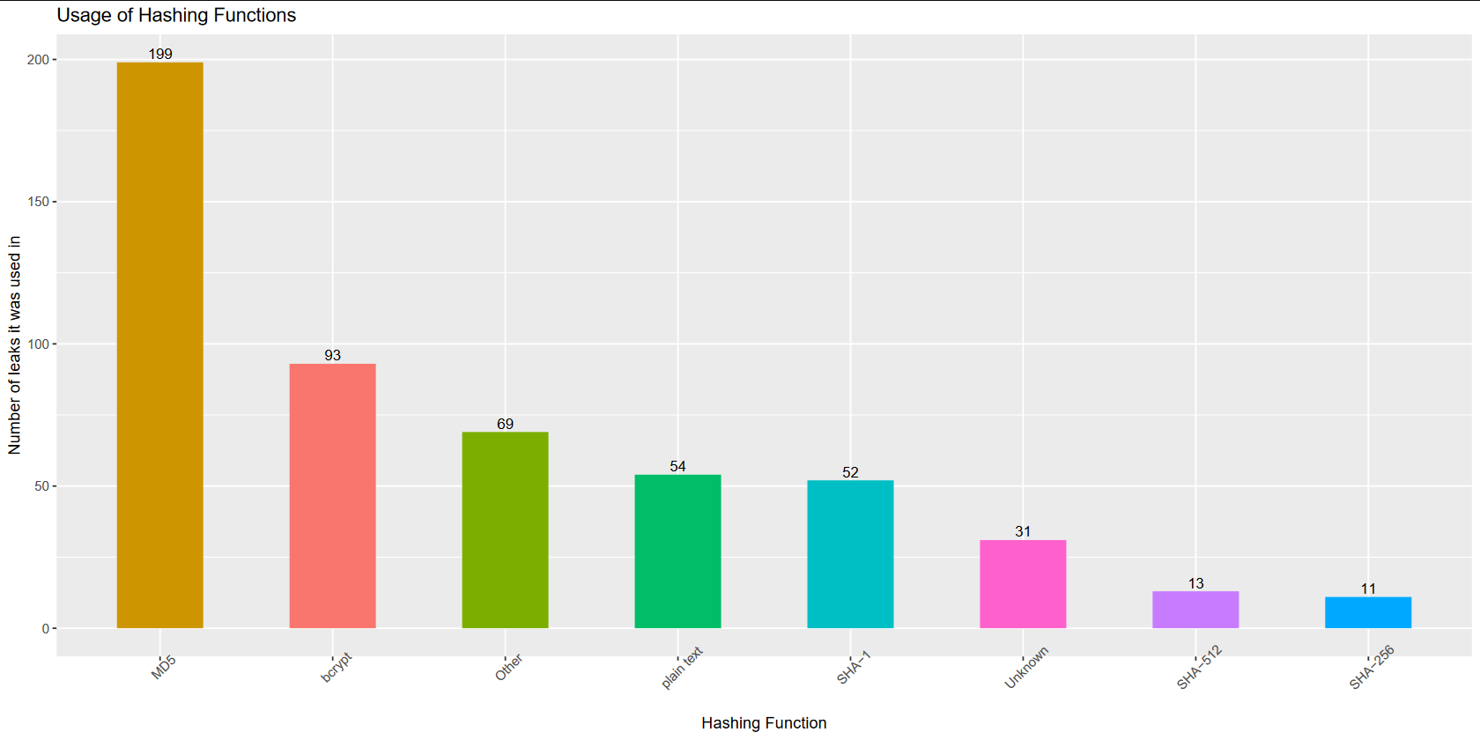
Hashing Overall
Notes:
Looking at the overall hashing, we can clearly see that MD5 is the most used hashing function. Next is bcrypt with almost two times less leaks. Also, bcrypt is the only “good” hashing function with a significant presence.

Slide 8
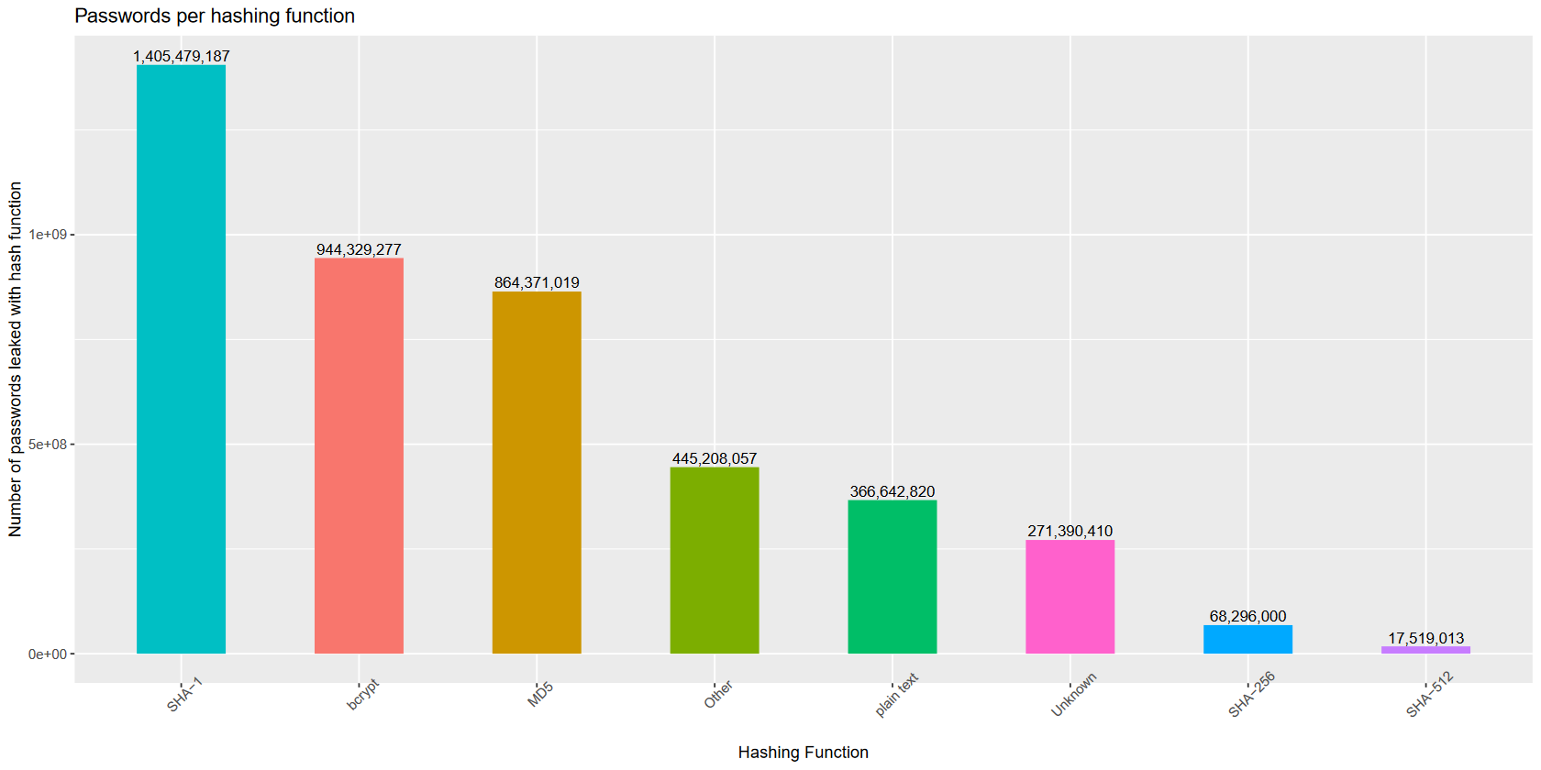
Number of Passwords
Notes:
Looking at the overall passwords leaked, we can see SHA-1 now has the upper hand, this with only 52 leaks. We can also see that bcrypt overtakes MD5, despite the much lower number of leaks, which suggests that bigger websites tend to be more security-aware than smaller websites would.

Slide 9
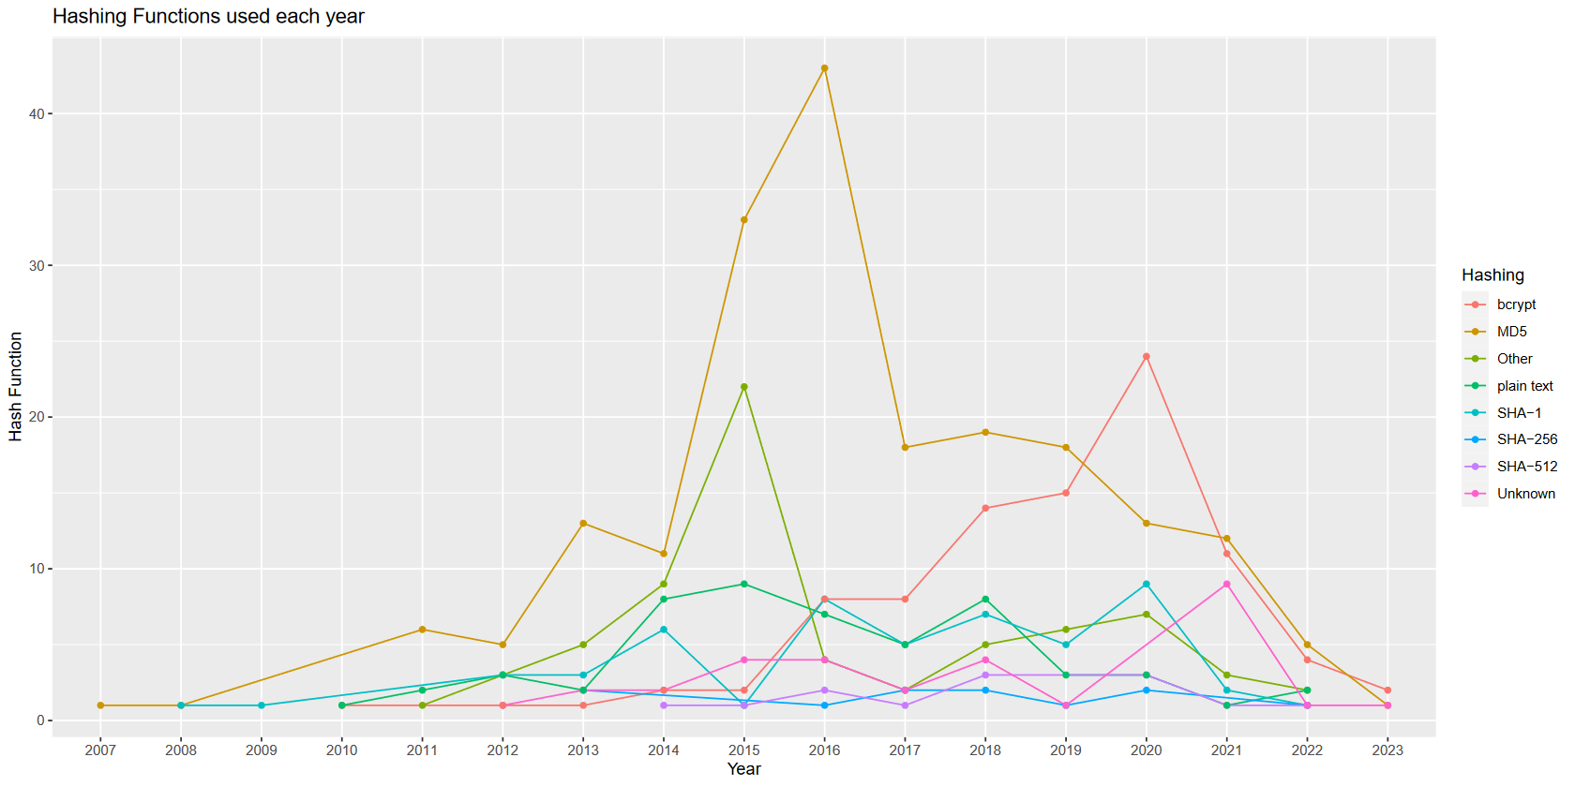
Hashing Over Time
HIBP created in 2013
recent leaks not discovered yet
Notes:
Her we will look at the same data, this time by displaying it over time. Of note is that HIBP was created in 2013, and so the rise in leaks before that year is not indicative of reality. Likewise, the dip in recent years, we argue, is because of leaks not being discovered yet, as the average time between a leak happening and then added to HIBP is 1.4 years.
Looking at the hashing over time, we can again see how MD5 is the most used hashing function, with the largest peak in 2016. This would make sense considering that a large portion of CMS platforms still use MD5 as their default hashing. Of note is the fact that bcrypt has started overtaking MD5 in recent years, which is a good sign.

Slide 10
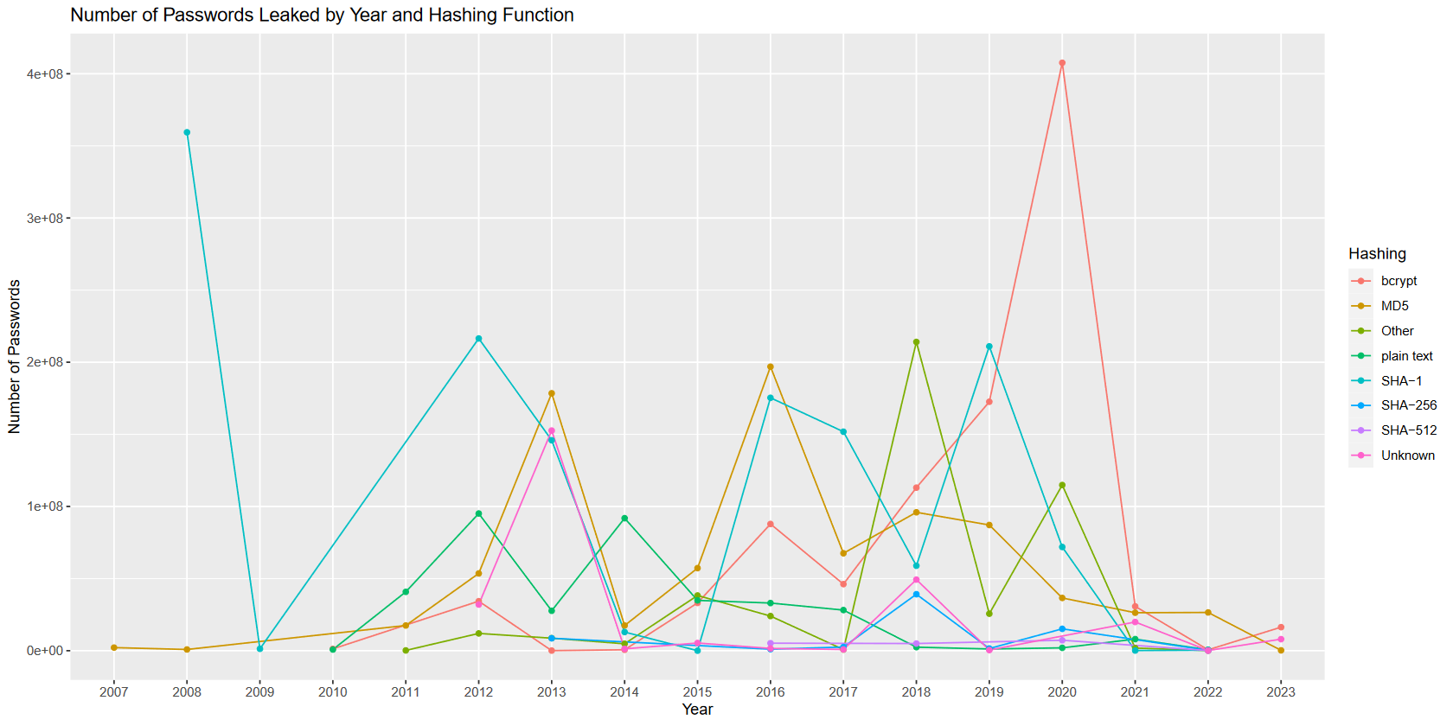
Passwords Over Time
Notes:
Looking at the number of passwords leaked over time, we can see that MD5 has a much less pronounced presence, signifying again that it is used by smaller websites.

Slide 11
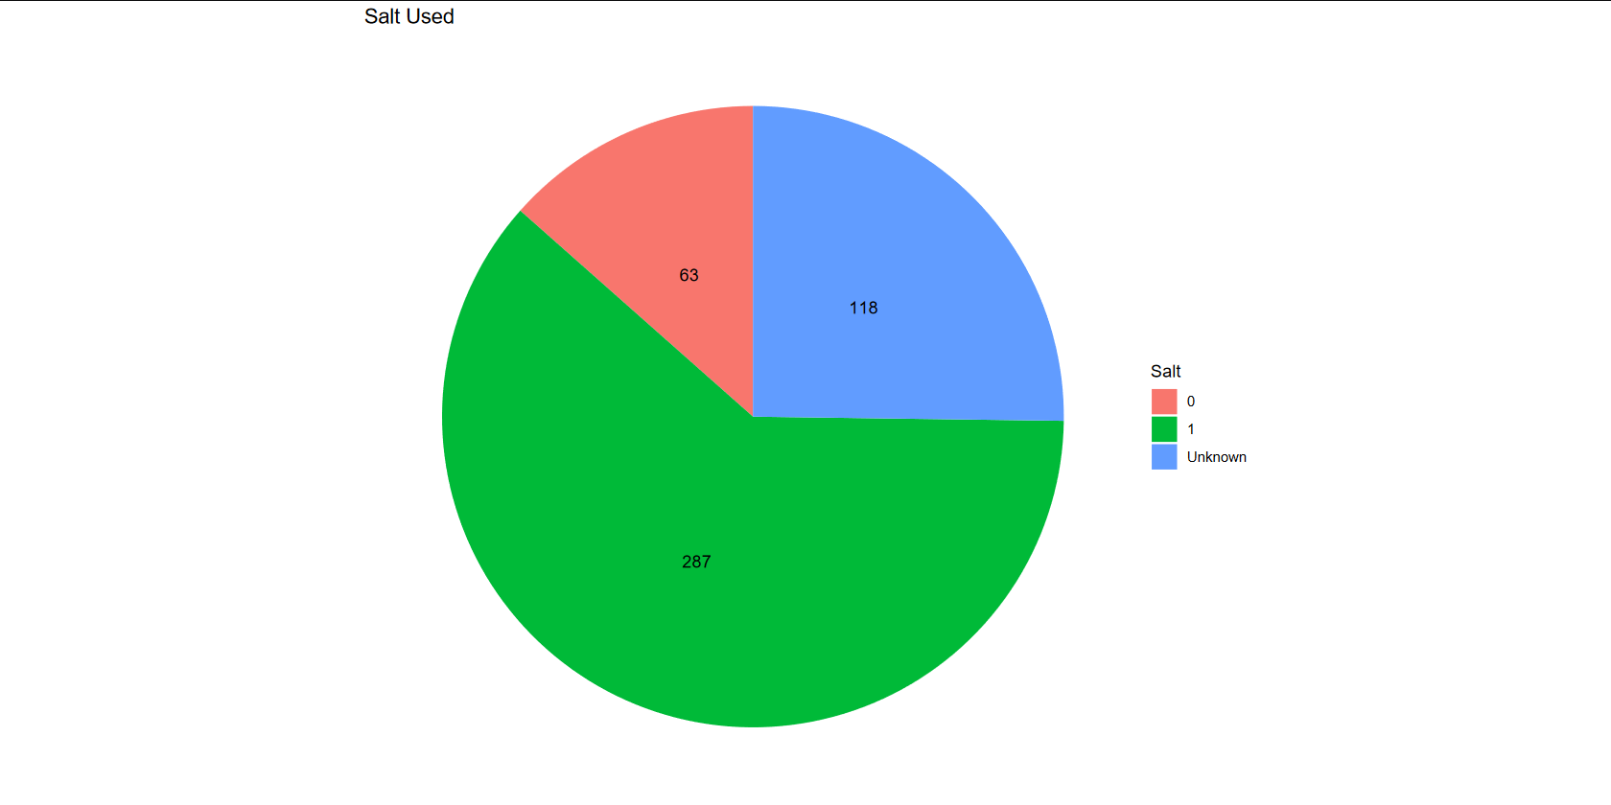
Salt Usage
Notes:
Looking at the salt usage, we see that a majority of websites do actually use salt. However, bcrypt does use salt by default, and so the distribution for functions where users can choose whether to use salt or not is worse than this chart.

Slide 12
Leaked Databases
Notes:
Here we will discuss the analysis we performed on the databases of leaked passwords we were able to find, which were also not used in many studies beforehand. We conducted this analysis using the ZXCVBN library, which is a password strength estimator.
This analysis proved to be very insightful, as it helped us show how custom dictionary attacks are good against themed websites,
the problems with using ZXCVBN in other languages,
how bot usage might look like,
while also helping us show the impact salt has on password cracking
Finally, it helped us start an argument that as password storage gets better, the passwords do as well.

Slide 13
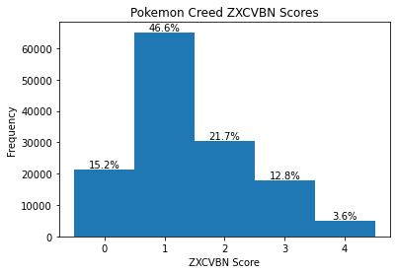
Pokemon Creed
21pokemon21
pokemonman
pikachu1
Notes:
Here we will discuss the analysis we performed on the databases of leaked passwords we were able to find, which were also not used in many studies beforehand. We conducted this analysis using the ZXCVBN library, which is a password strength estimator.
This analysis proved to be very insightful, as it helped us show how custom dictionary attacks are good against themed websites,
the problems with using ZXCVBN in other languages,
how bot usage might look like,
while also helping us show the impact salt has on password cracking
Finally, it helped us start an argument that as password storage gets better, the passwords do as well.

Slide 14
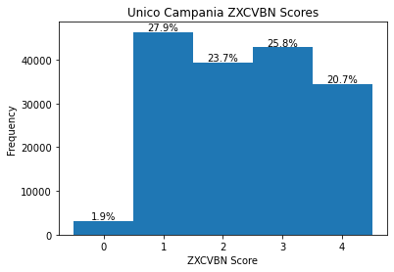
Unico Campania
motorcycle = 1
motocicletta = 4
Notes:
Here we will discuss the analysis we performed on the databases of leaked passwords we were able to find, which were also not used in many studies beforehand. We conducted this analysis using the ZXCVBN library, which is a password strength estimator.
This analysis proved to be very insightful, as it helped us show how custom dictionary attacks are good against themed websites,
the problems with using ZXCVBN in other languages,
how bot usage might look like,
while also helping us show the impact salt has on password cracking
Finally, it helped us start an argument that as password storage gets better, the passwords do as well.

Slide 15

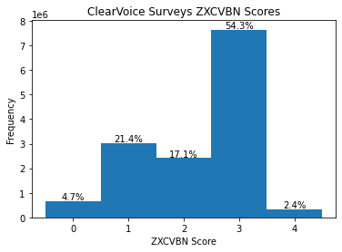
ClearVoice Surveys
Notes:
Here we will discuss the analysis we performed on the databases of leaked passwords we were able to find, which were also not used in many studies beforehand. We conducted this analysis using the ZXCVBN library, which is a password strength estimator.
This analysis proved to be very insightful, as it helped us show how custom dictionary attacks are good against themed websites,
the problems with using ZXCVBN in other languages,
how bot usage might look like,
while also helping us show the impact salt has on password cracking
Finally, it helped us start an argument that as password storage gets better, the passwords do as well.

Slide 16
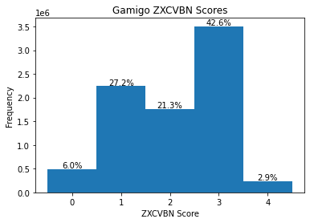
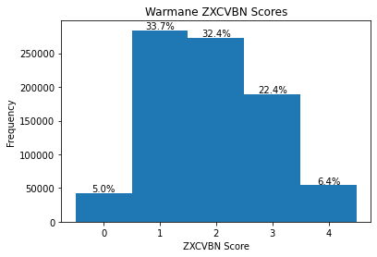
Gamigo & Warmane
Notes:
Here we will discuss the analysis we performed on the databases of leaked passwords we were able to find, which were also not used in many studies beforehand. We conducted this analysis using the ZXCVBN library, which is a password strength estimator.
This analysis proved to be very insightful, as it helped us show how custom dictionary attacks are good against themed websites,
the problems with using ZXCVBN in other languages,
how bot usage might look like,
while also helping us show the impact salt has on password cracking
Finally, it helped us start an argument that as password storage gets better, the passwords do as well.

Slide 17
Gamigo & Warmane
Both leaks initially hashed with MD5
Warmane used salting, Gamigo did not
Both came from the same source
Gamigo missing 6.5 thousand out of 8.2 million passwords (0.8%)
Warmane missing 273 thousand out of 1.1 million passwords (24.5%)
Notes:
Here we will discuss the analysis we performed on the databases of leaked passwords we were able to find, which were also not used in many studies beforehand. We conducted this analysis using the ZXCVBN library, which is a password strength estimator.
This analysis proved to be very insightful, as it helped us show how custom dictionary attacks are good against themed websites,
the problems with using ZXCVBN in other languages,
how bot usage might look like,
while also helping us show the impact salt has on password cracking
Finally, we compared our results, and started an argument that as password storage gets better, the passwords do as well.

Slide 18
Gamigo & ClearVoice Surveys
Notes:
Here we will discuss the analysis we performed on the databases of leaked passwords we were able to find, which were also not used in many studies beforehand. We conducted this analysis using the ZXCVBN library, which is a password strength estimator.
This analysis proved to be very insightful, as it helped us show how custom dictionary attacks are good against themed websites,
the problems with using ZXCVBN in other languages,
how bot usage might look like,
while also helping us show the impact salt has on password cracking
Finally, we compared our results, and started an argument that as password storage gets better, the passwords do as well.

Slide 19
Gamigo & Warmane
Notes:
Here we will discuss the analysis we performed on the databases of leaked passwords we were able to find, which were also not used in many studies beforehand. We conducted this analysis using the ZXCVBN library, which is a password strength estimator.
This analysis proved to be very insightful, as it helped us show how custom dictionary attacks are good against themed websites,
the problems with using ZXCVBN in other languages,
how bot usage might look like,
while also helping us show the impact salt has on password cracking
Finally, we compared our results, and started an argument that as password storage gets better, the passwords do as well.

